Slide 1
Friction

Slide 2
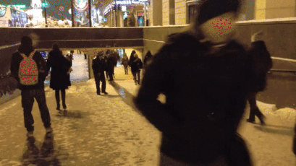
It can be a slippery concept but by the end of this lesson you will be able to:
Define friction.
Describe the difference between useful and unwanted friction.
Identify whether friction is useful or unwanted in different scenarios.

Slide 3
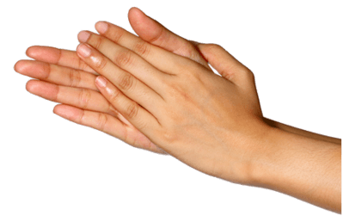
Friction is a force that always opposes the motion of an object.
Friction is an example of a contact force because it requires the object to be touching something else. It is caused by two surfaces rubbing against each other, or an object rubbing against a surface.
If you rub your hands together very fast, you can feel the friction between them. Your hands get hot as a result.

Slide 4
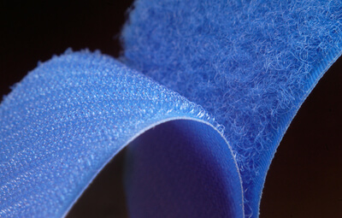
The rougher the surface is, the greater the friction force.
If you have ever dragged a piece of furniture across a carpet, you will know that friction can make it a hard job.
When an object moves across a rough surface, friction slows it down. This is because the surfaces of the object and the floor are covered in lots of bumps and grooves that tangle together as the object moves.

Slide 5
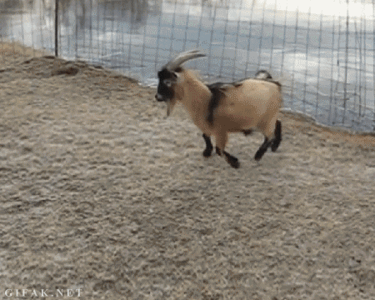
Conversely, very smooth surfaces create little or no friction.
Ice is very smooth and slippery, so when you slide over it, the force of friction is very small. This is why vehicles on icy roads cannot slow down as quickly - there is less friction to slow them.

Slide 6
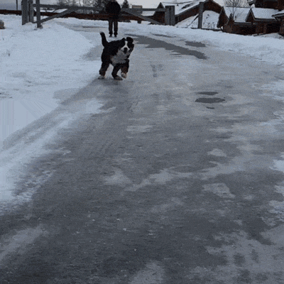
Friction can be helpful or a nuisance, depending on the situation.
Without the force of friction, you would not be able to walk or run. Instead you'd be sliding and slipping everywhere, unable to stop until you hit a wall. It would be like everything was made of ice!
Friction between your feet and the ground is what lets you control your movement. In this way it is very helpful.

Slide 7
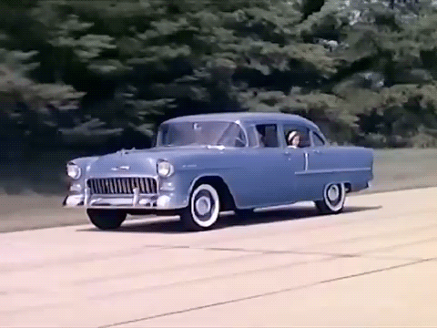
Air resistance is a form of friction that comes from contact with air.
Imagine being caught in a strong gust of wind - air can produce a lot of force!
You don't notice the force of air resistance when you're moving slowly. However, at high speeds it becomes a major concern.
The top speed of a car depends on how streamlined it is. Streamlined cars move more easily through air, so the air resistance acting on them is less.

Slide 8
